Slide 1

Hide and Seek
Crystal Monica Abou Jneid – Mia Antoun – Edwin Odeimi
Dr. Joe Tekli

Slide 2
Game path

Slide 3
Game path
First, the users must login
Then the users enter the first round
When first round ends, the second round begins
When the second round ends, the game is terminated

Slide 4
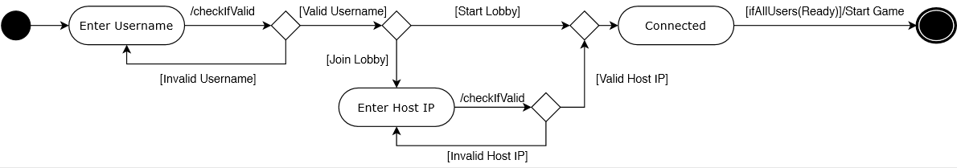
Login
Users must login first in order to enter the game:

Slide 5
Login
Condition | Action
Username contains less than five characters | ERROR: Invalid username.
Username contains empty space characters | ERROR: Invalid username.
Username does not start with an underscore character o a letter | ERROR: Invalid Username.
Any of the remaining letters is that is not a number, an underscore character or a letter | ERROR: Invalid Username.
The username must follow certain rules.
Any of these conditions that is not met will generate an error message.

Slide 6
Login
Condition | Action
Textbox contains characters that are not digits | ERROR: Invalid IP address.
Textbox does not correspond to the rightmost three digits of the host | ERROR: Invalid IP address.
The textbox must follow certain rules.
Any of these conditions that is not met will generate an error message.

Slide 7
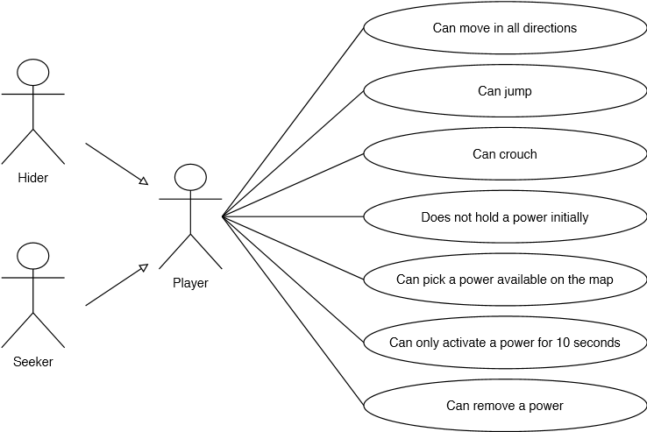
Entering the game
When the game starts, the clients and the host become players.
They are randomly divided into hiders and seekers.

Slide 8
Entering the game
1- The Hiders’ powers can be any of the following:
Shrinking
Invisibility
Passing through walls
Transforming into a prop (any object that belongs to its environment).
2- The Seekers’ powers can be any of the following:
Can make the nearest Hider to emit a sound which will make him easily detectable.

Slide 9
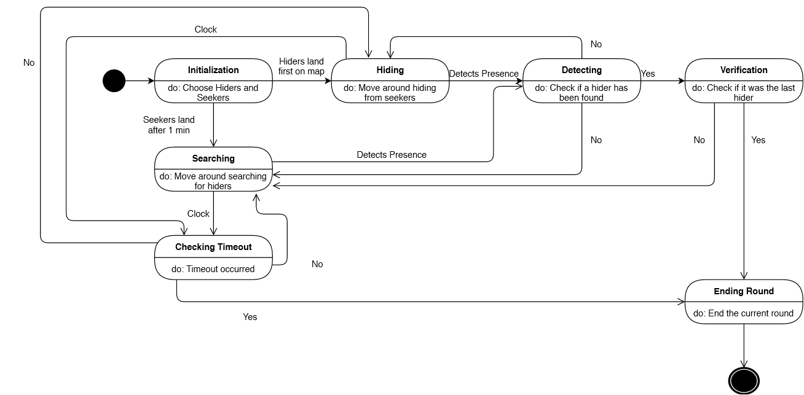
Game description
The first round starts, it works as follows:

Slide 10
Game description
State | Description
Initialization | The hiders and seekers are chosen randomly such as half of the players are hiders and the other half are seekers.
Hiding | The hiders move around hiding from the seekers
Searching | The seekers move around trying to find the hiders.
Detecting | Checking if a hider has been detected.
Checking Timeout | Checks if a timeout occurred.
Verification | Checks if the hider that was found was the last hider.
Ending Round | The current round terminates.
The username must follow certain rules.
Any of these conditions that is not met will generate an error message.

Slide 11
Game description
Additional notes:
The map contains a circle zone such that the center of this circle is chosen randomly.
This circle shrinks every other minute in size.
When the Hiders are outside the circle, a storm appears to them.
However, this storm does not appear to the Seekers.
Because of this storm, the Hiders easily detectable.
Hiders cannot stay at the same location.

Slide 12
Game description
When the first round ends, the second round begins.
The second round operate in the same way as the first round.

Slide 13
Note
The host sends the IP address of the first user that was “Connected” to the game, to all remaining “Connected” users to the game from to the time at which all users were “Connected” until the middle of the game.
In case the host leaves the game early:
The first player that was “Connected” to the game will become the host.
The other users will attempt to connect to the newly designated host.
Each user will be given ten attempts in order to try to establish a connection with the host.
If after ten attempts the user fails to connect to the host, he will be redirected to the second scene, in which he has to choose between the “start lobby” button and the “join lobby” button.

